Slide 1
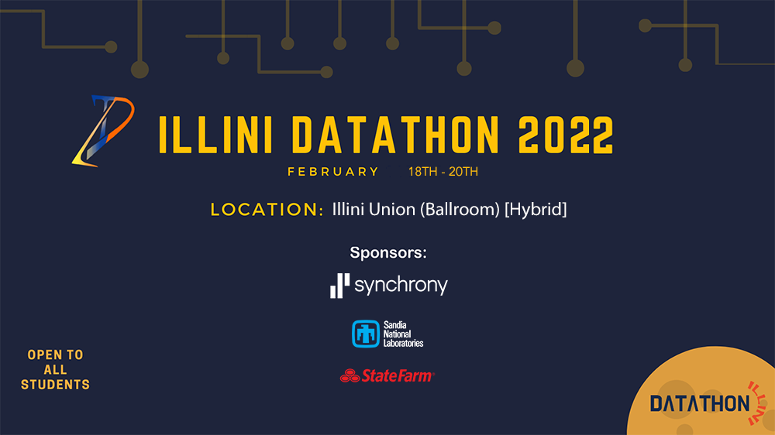

Slide 2

Datathon Schedule
Friday
Sunday
Saturday
6:00 PM CHECK IN
7:00 PM OPENING CEREMONY
8:30 PM MENTORING/ DINNER
10:00 PM MENTORING ENDS

Slide 3
Datathon Schedule
(Discord)
Friday
Saturday
Sunday
10:00 AM MENTORING HOURS
2:00 PM SYNCHRONY WORKSHOP (Sentiment Analysis)
3:00 PM SANDIA WORKSHOP (Bias - Variance tradeoff)
4:00 PM MENTORING HOURS
6:00 PM MENTORING ENDS

Slide 4
Datathon Schedule
Friday
Saturday
Sunday
10:00 AM SUBMISSION DEADLINE
7:00 PM FINAL CEREMONY

Slide 5

A word from Our Sponsor

Slide 7

We are the largest private label credit card company in the U.S. based on purchase volume and receivables.
Business Leadership Program

Slide 8



WHO WE ARE
We’re a premier consumer financial services company delivering customized financing programs across key industries including retail, health, auto, travel and home. Along with award-winning consumer banking products, we bring deep industry expertise, actionable data insights, innovative solutions and differentiated digital experiences to improve the success of every business we serve and the quality of each life we touch.
89
68M+
16K+
YEARS OF HISTORY
Built One Customer
At A Time
ACTIVE CUSTOMERS
Accounts Across
Multiple Industries
EMPLOYEES
Each One Integral
To Our Business

Slide 9












DIGITAL
PLATFORMS & PRODUCTS
Synchrony has and is continuing to build a robust portfolio of consumer financial products that positively impact consumers’ lives in multiple, meaningful ways.
HEALTH
& WELLNESS
HOME
& AUTO
DIVERSIFIED
& VALUE
LIFESTYLE

Slide 10

A word from Our Sponsor

Slide 11
Sandia National Laboratories
World-changing technologies. Life-changing careers.
SAND2021-11298 HR

Slide 12

Sandia National Laboratories
World-changing technologies. Life-changing careers.
SAND2021-11298 HR

Slide 13
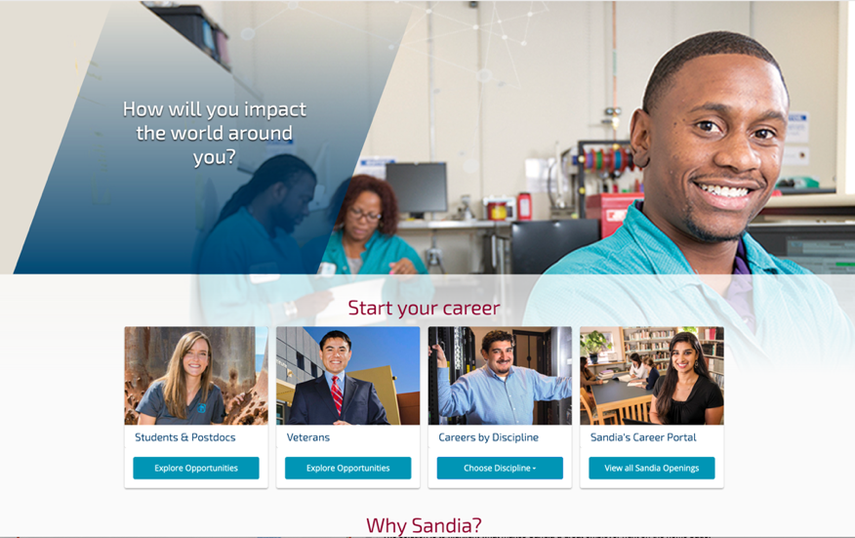
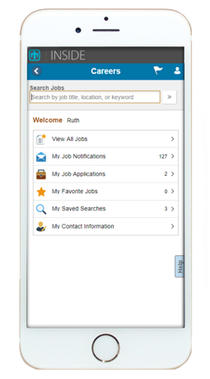
Apply Online! sandia.gov/careers
Sign up for Automated Job Notifications!
Mobile Job Applications
Ask us questions during the mentoring hours.

Slide 14

A word from Our Sponsor

Slide 16
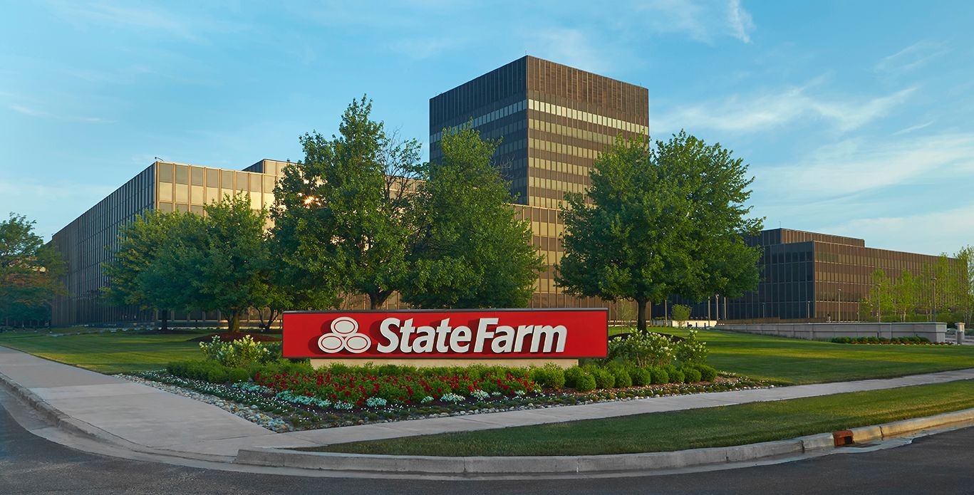
State Farm Insurance Companies Headquarters

Slide 17
Data Science & Machine Learning at State Farm
Data Scientist
Data Engineer
Machine Learning Engineer
Software Engineer
Technology Engineer
Data Analyst
Software Developer

Slide 18



Transforming Big Data into Actionable Understanding and Competitive Advantage
Exploratory analysis
Forecasting and Econometric Modeling
Experimental Design
Data Visualization
Statistical Education
Predictive Modeling
Natural Language Processing (NLP)
Other analytic methods (simulation, cluster analysis, etc.)

Slide 19
Internship Opportunities
Champaign IL
(Research and Development Center)
Bloomington IL
(Corporate)
Hub Locations
- Dallas TX
- Atlanta GA
- Phoenix AZ

Slide 20
Contact Us
Allegra Thigpen
allegra.thigpen.j5mt@statefarm.com
Heather Park
heather.park.tmtk@statefarm.com
Kailun Zheng
kailun.zheng.wggz@statefarm.com
Vissy Ru
vissy.ru.ep68@statefarm.com

Slide 22
A word from Our Sponsor

Slide 23
PROBLEM STATEMENT
Customers chat with us for various reasons about their account - whether it’s to ask about when their payment is due, to request a late fee waiver, or to close their account. They first engage with the chat bot Sydney and then with a live agent if Sydney can’t help. Based on just the chat transcripts, how can you determine if a customer was dissatisfied with their experience? And is there a reason that causes more dissatisfaction with Sydney than an agent? Or vice versa?

Slide 24
Helpful Hints
You should provide the rationale why certain metric of choice is useful.
The development team is a very visual team so create some appealing data visualizations to get buy-in from your marketing peers (it also helps to know more about marketing and advertising process).
Finally, a good pitch combines data, storytelling, and awareness of the business goals.

Slide 25
Deliverables
01
02
Max 7-minute video
Sell us your recommendations in an elevator – why should we care and what did you learn?
Presentation
You will provide an overview why your solution is sound and responsive to the problem.
03
Model
Give us your model output on Readme file in the git repository, highlighting your methods and results.
04
Code
We want to be able to replicate your results to make sure it wasn’t a fluke

Slide 26
Video Submission Criteria
A 7-minute (MAX) pitch video
Can be structured however you want to solution your idea/findings/suggestions
Try to highlight the biggest points in your data collection and research
Try incorporating what you have learned during this process both technically and socially (team dynamics)
Only 1 person required to be in the video
Create an unlisted YouTube video and then link the video to the Readme file on your repository

Slide 27
CRITERIA
All deliverables will be taken into consideration during judging. The following criteria will be on a 5-point scale and will be weighted equally.
ACCURACY
Based on accuracy metric of your choice
Takes into account possibility of skewed data
METHOD
Model fit and techniques
Creative, innovative approach
PRESENTATION
Engaging presentation
Clear, thoughtful explanations
Supportive visualizations
APPLICABILITY
Solution addresses given business problem
Proposed solution can be implemented in similar real life situations

Slide 28
Rules
All submissions must be in by 10:00 am on Sunday. There will be no exceptions.
All submissions must have all 4-deliverables or they won’t be counted.
We are looking for clarity and ability to answer both business and data science questions not for flashiness of submissions. Work on what counts.
Teams can leverage any publicly available data source for generating input features in addition to the provided data set.
Teams can leverage any tools and/or libraries for this task but must provide the links for those tools in their code deliverable.
Teams are not allowed to ask anyone outside of mentors or their own team for help. Please do your own work because this is a learning opportunity first and foremost.
Be courteous to your peers as you work.
Have fun and get to know your fellow competitors and mentors.

Slide 29
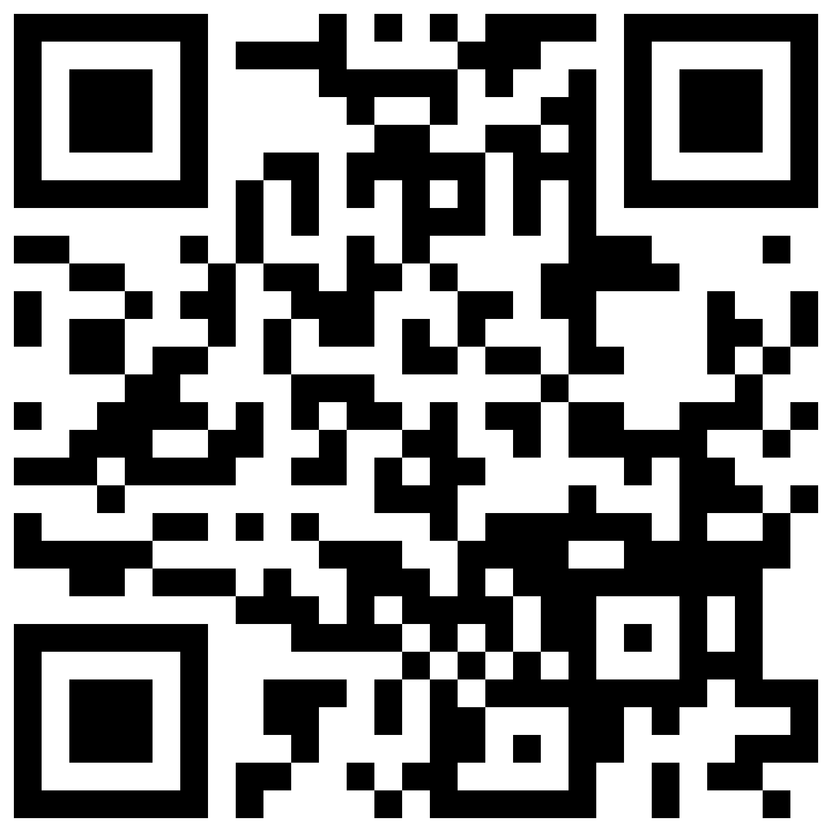
Submission Guidelines
Make sure to upload all of your files to your respective Git repository.
Here is a link to your Data set:
https://uofi.box.com/s/zqyhuc28z0rz6c3uldpnlsc307pfyrdz
If you have any question about submissions, make sure to either approach us, send an email to illinidata@gmail.com, send us a message in the discord server (link below):
https://discord.gg/N6jxs7tDUe
Everything is available at Datathon Website: https://publish.illinois.edu/illini-datathon/

Slide 30
Meme Competition
Be sure not write something inappropriate.
All submissions are through the #meme channel on discord.
Best meme will get an Illini Datahon The North Face jacket.

Slide 31
Resources

Slide 32
R Resources
Useful R Libraries
Data loading – DBI, odbc, RMySQL, xlsx, haven
Data manipulation – dplyr, tidyr, stringr
Visualizations – ggplot2, rgl, htmlwidgets
Modeling – car, mgcv, lme4/nlme, randomForest, vc, glmnet, caret
Spatial data – sp, maptools, maps, ggmap, leaflet, R-ArcGIS bridge
https://support.rstudio.com/hc/en-us/articles/201057987-Quick-list-of-useful-R-packages
R Resources
https://www.r-project.org/
https://rstudio.com/
https://www.codecademy.com/learn/learn-r
https://www.coursera.org/learn/r-programming
https://www.datacamp.com/
https://www.lynda.com/R-training-tutorials/1570-0.html
https://www.reddit.com/r/Rlanguage/
https://stackoverflow.com/questions/tagged/r

Slide 33
Python Resources
Useful Python Libraries
https://geopandas.org/
https://gdal.org/
https://numpy.org/
https://pandas.pydata.org/
https://matplotlib.org/
https://scikit-learn.org/stable/
https://www.reportlab.com/
Python Resources
https://www.learnpython.org/
https://www.codecademy.com/learn/learn-python-3
https://www.python.org/about/gettingstarted/
https://docs.python-guide.org/intro/learning/

Slide 34
NLP Resources
NLP with Deep learning By Stanford University: https://www.youtube.com/playlist?list=PL3FW7Lu3i5Jsnh1rnUwq_TcylNr7EkRe6
Coursera: https://www.coursera.org/learn/language-processing
NLP course by Oxford University (GitHub Repository): https://github.com/oxford-cs-deepnlp-2017/lectures/blob/master/README.md
Deep Learning for Natural Language Processing: Tutorials with Jupyter Notebooks: https://insights.untapt.com/deep-learning-for-natural-language-processing-tutorials-with-jupyter-notebooks-ad67f336ce3f
How to solve 90% of NLP problems: a step-by-step guide: https://blog.insightdatascience.com/how-to-solve-90-of-nlp-problems-a-step-by-step-guide-fda605278e4e
Twitter Sentiment Analysis Using Combined LSTM-CNN Models: https://konukoii.com/blog/2018/02/19/twitter-sentiment-analysis-using-combined-lstm-cnn-models/
Keras LSTM tutorial – How to easily build a powerful deep learning language model: http://adventuresinmachinelearning.com/keras-lstm-tutorial/
Natural Language Processing with Python – Analyzing Text with the Natural Language Toolkit: https://www.nltk.org/book/

